Slide 1

Introduction to Amazon Sales Analysis
Overview of sales management importance.
Problem statement: Increasing competition and the need for better distribution methods to reduce costs and increase profits.
Objective: Analyze sales trends and identify key metrics to improve decision-making.

Slide 2
Data Overview
Dataset description: Source, time period covered, and key attributes (e.g., region, item type, sales channel).
ETL process summary: Steps for data extraction, transformation, and loading.
Tools used: Tableau for visualization, and any other tools for ETL.

Slide 3
Total Revenue: $137.35M
Total Profit: $44.17M
Total Units Sold: 512,871
Average Unit Price: $276.76
Average Unit Cost: $191

Slide 4

Sales Trend analysis

Slide 5
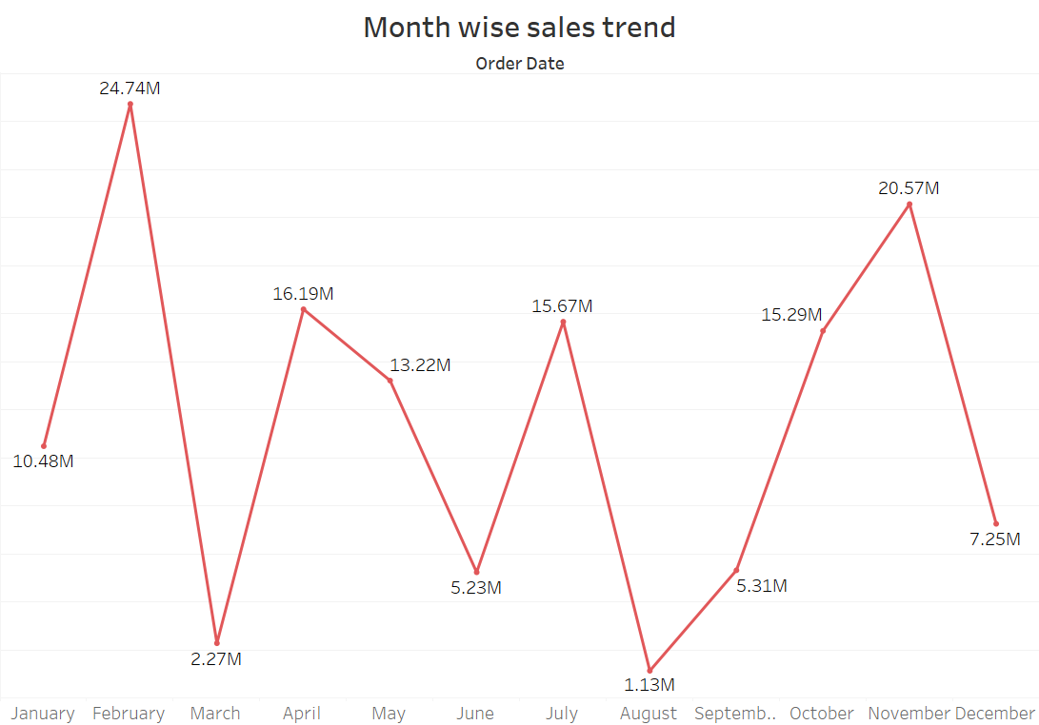
Monthly Sales Trend
Peak Sales: January ($24.74M) and October ($20.57M) show strong seasonal sales, indicating high demand at the beginning and end of the year.
Low Sales: February ($2.27M) suggests a post-holiday dip, while August ($1.13M) marks the lowest sales, possibly due to seasonal factors, operational issues, or shifts in consumer behavior. August's significant drop requires further investigation.

Slide 6
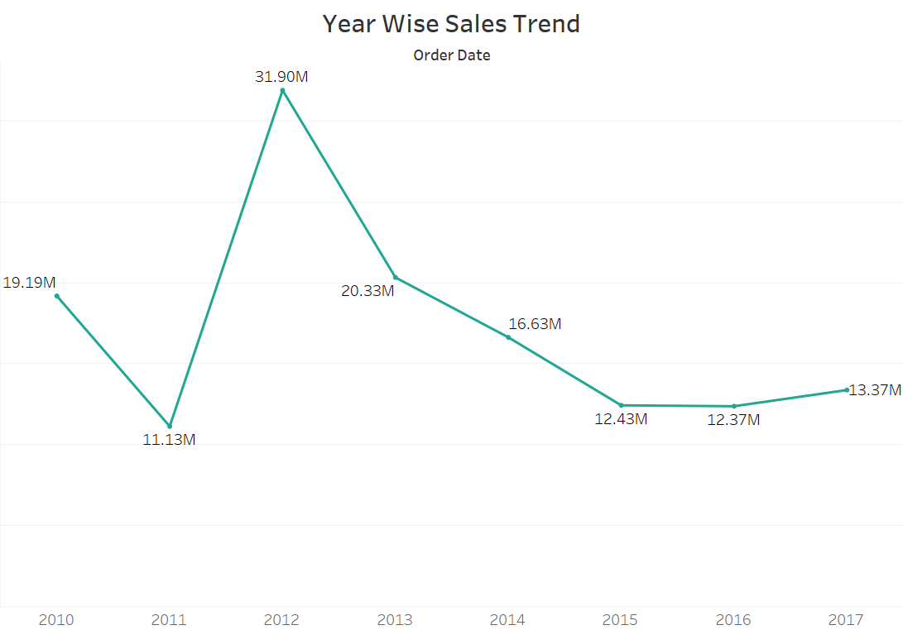
Yearly Sales Trend
The trend shows a significant increase in sales from 2010 to 2012, peaking at 31.90M in 2012.
However, there is a noticeable decline from 2013 onwards, with a slight recovery in 2017

Slide 7
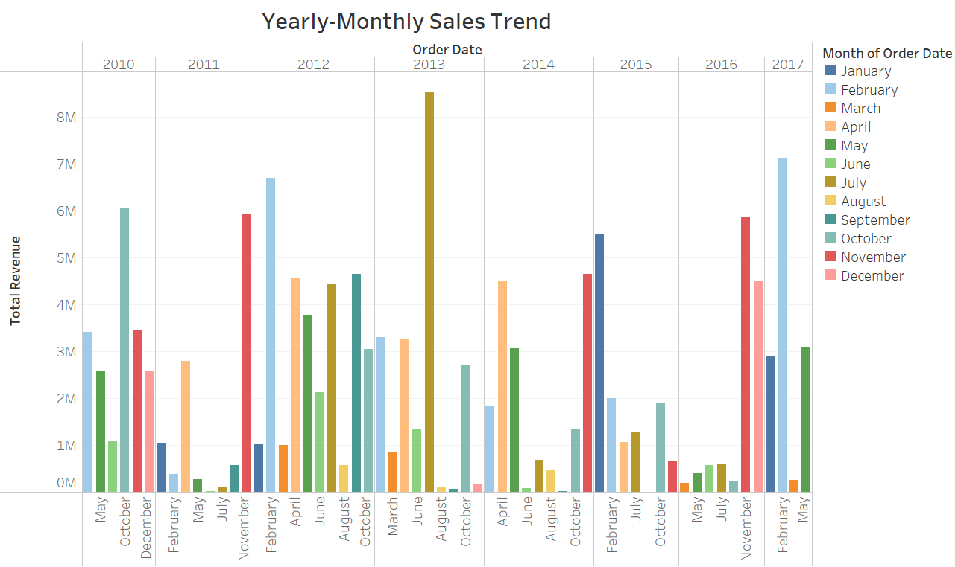
Monthly Yearly Sales Trend
Consistent high sales in certain months across years, indicating strong seasonal demand that can be capitalized on.

Slide 8
Key Metrics and Factors

Slide 9
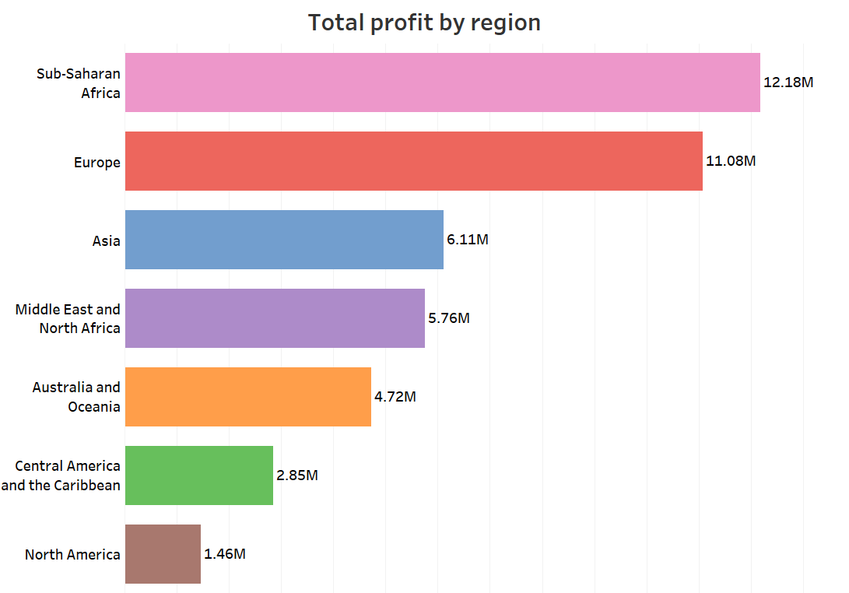
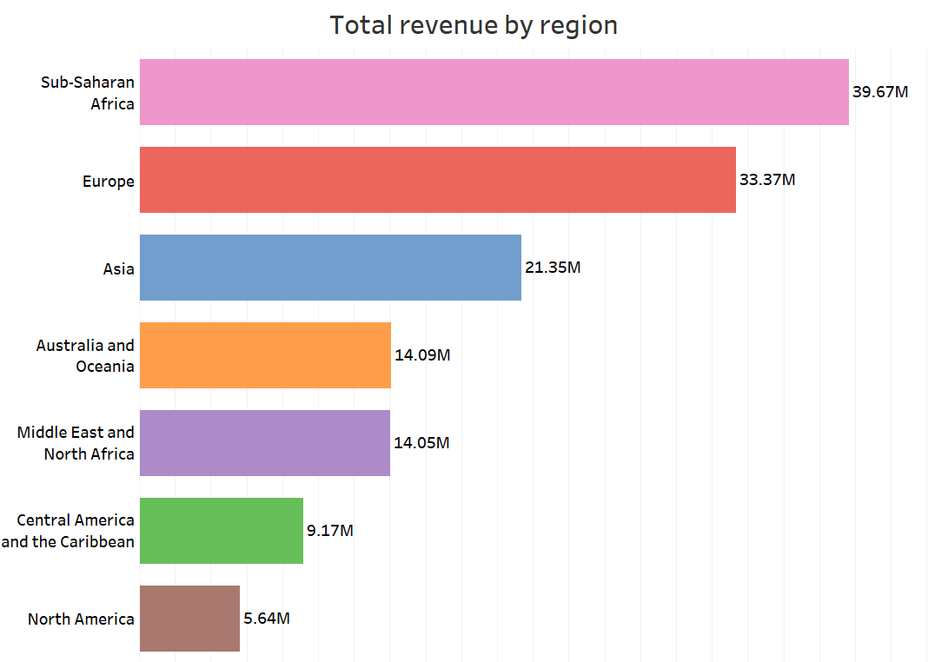
Total Revenue and Profit by Region
Sub-Saharan Africa is the top-performing region with $39.67M in revenue and $12.18M in profit.
North America lags significantly with only $5.64M in revenue, signaling a potential area for market development.

Slide 10
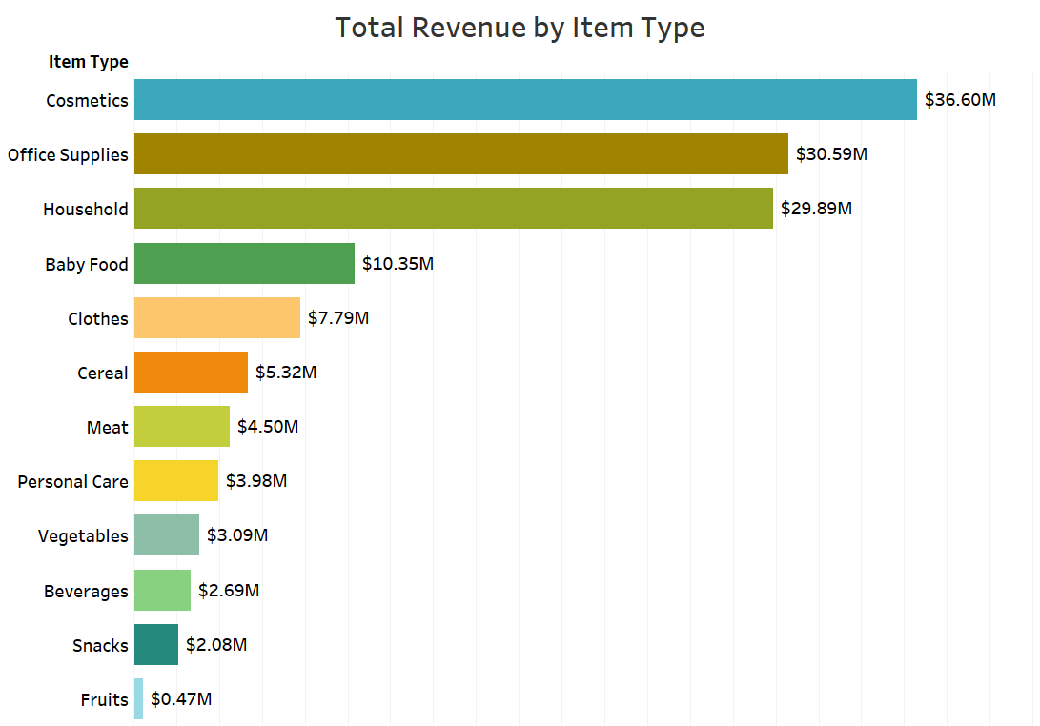
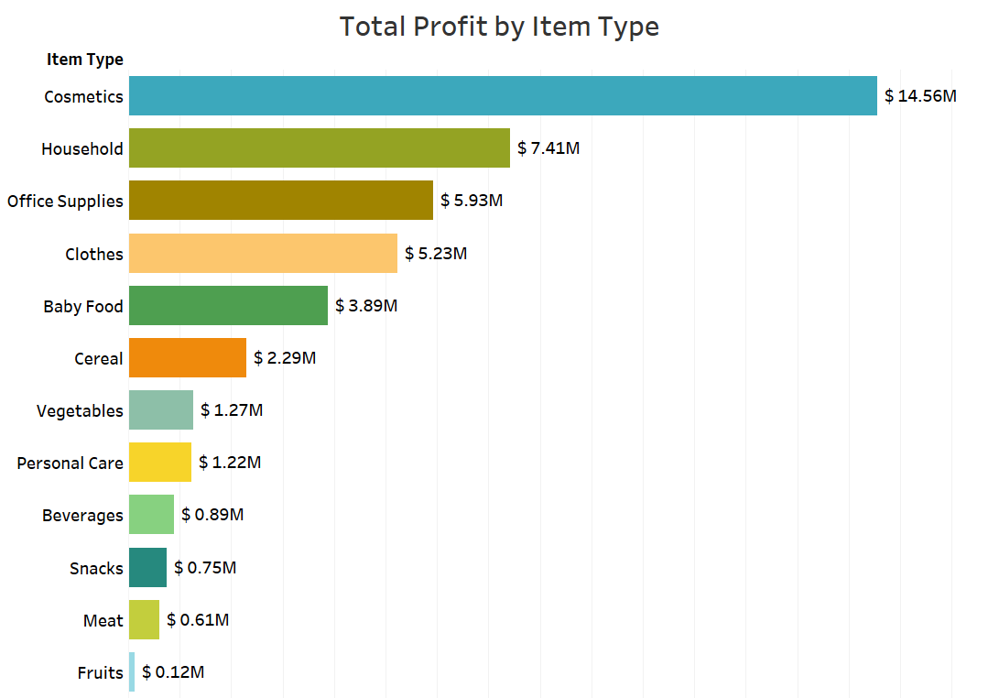
Revenue and Profit by Item Type
Cosmetics and Household items are the top profit generators, contributing $14.56M and $7.41M, respectively.
Categories like Fruits, Meat, and Snacks have minimal contributions, indicating areas that might need reevaluation or strategic marketing efforts to improve performance.

Slide 11
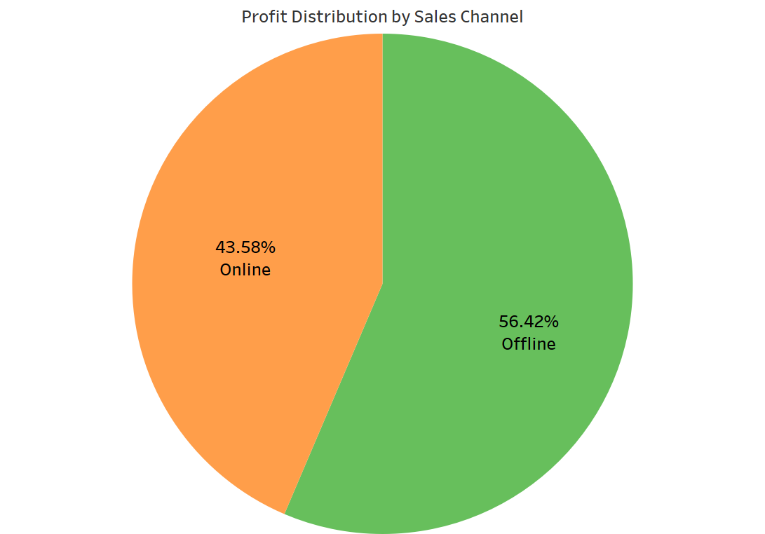
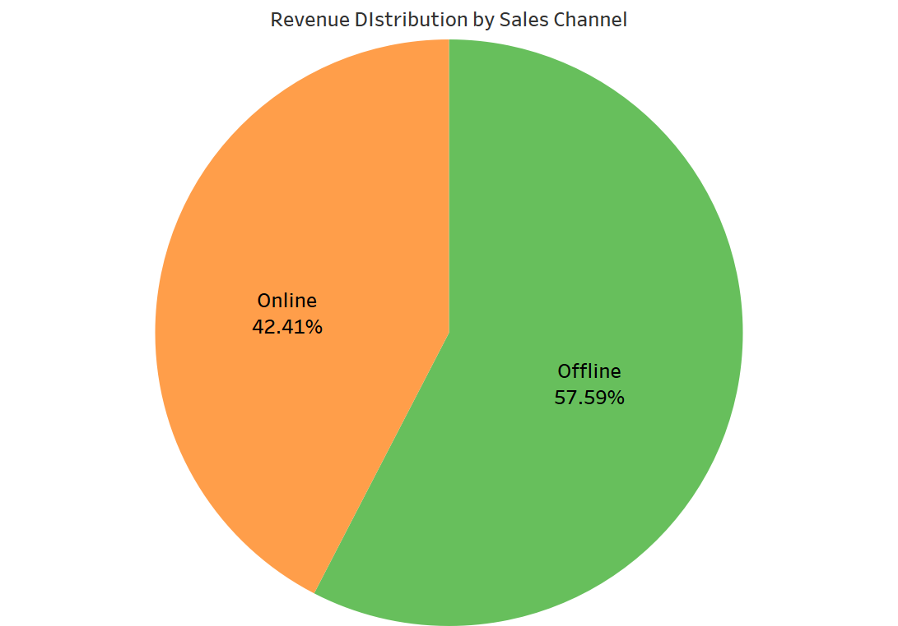
Sales Channel Performance
Offline sales account for 57.59% of revenue but only 56.42% of profit, suggesting that the online channel, though smaller, might be more efficient.

Slide 12

Relationship Between attributes

Slide 13
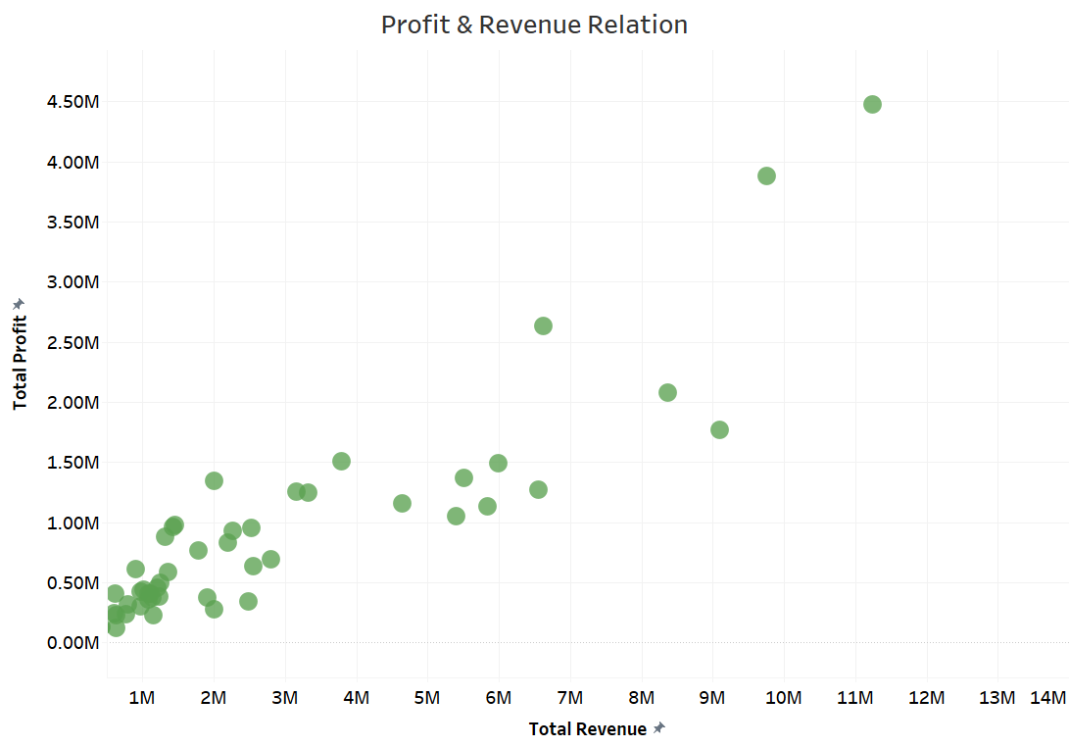
Profit vs. Revenue
Strong correlation between profit and revenue, with outliers suggesting potential for optimization in low-profit regions or products.

Slide 14
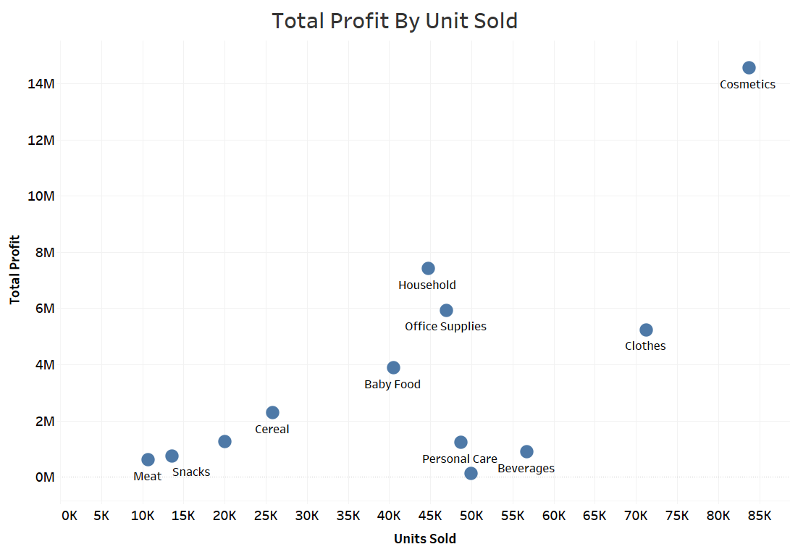
Profit by Units Sold
Some high-volume products have low profit margins, indicating a need to reassess pricing or cost structures.

Slide 15
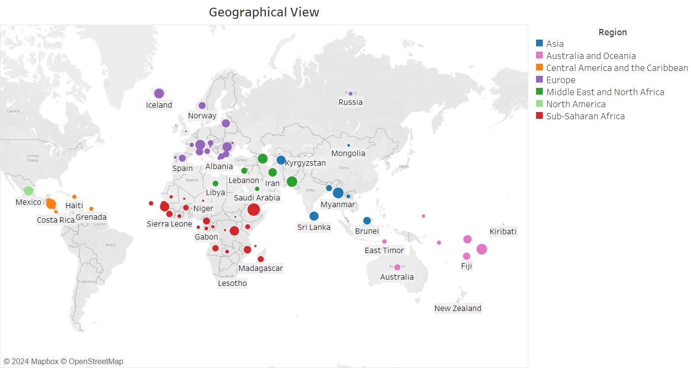
Geographical View
Significant sales in Europe and Sub-Saharan Africa, with opportunities to expand in underperforming regions like North America.

Slide 16
Recommendations for Business Improvement
Focus on
Focus on High-Margin Regions: Increase marketing and distribution efforts in high-profit regions like Sub-Saharan Africa.
Optimize
Optimize Product Portfolio: Invest in top-performing categories like Cosmetics and Household items, while reconsidering or revamping strategies for underperforming categories like Fruits, Meat, and Snacks.
Channel
Channel Strategy: Strengthen online presence to capitalize on its higher efficiency while maintaining efficient offline operations.
Leverage
Seasonal Promotions: Leverage peak sales months with targeted promotions to maximize revenue and profits during high-demand periods.

Slide 17
Conclusion
Sales Trend Analysis:
Peak in 2012; decline from 2013 with a slight recovery in 2017.
Monthly Peaks: January and October; dips in February and August.
Key Metrics Analysis:
Top Region: Sub-Saharan Africa; Lowest Region: North America.
Top Products: Cosmetics and Household items; Low Performers: Fruits and Meat.
Sales Channels: Offline sales lead in revenue but online sales are more profitable.

Slide 18
Conclusion
Relationship Insights:
Strong correlation between profit and revenue.
High-volume products may have low profit margins.
Recommendations:
Revitalize strategies for declining periods.
Optimize product mix and enhance online sales.
Expand in underperforming regions.

Slide 19
Dashboard

Slide 20
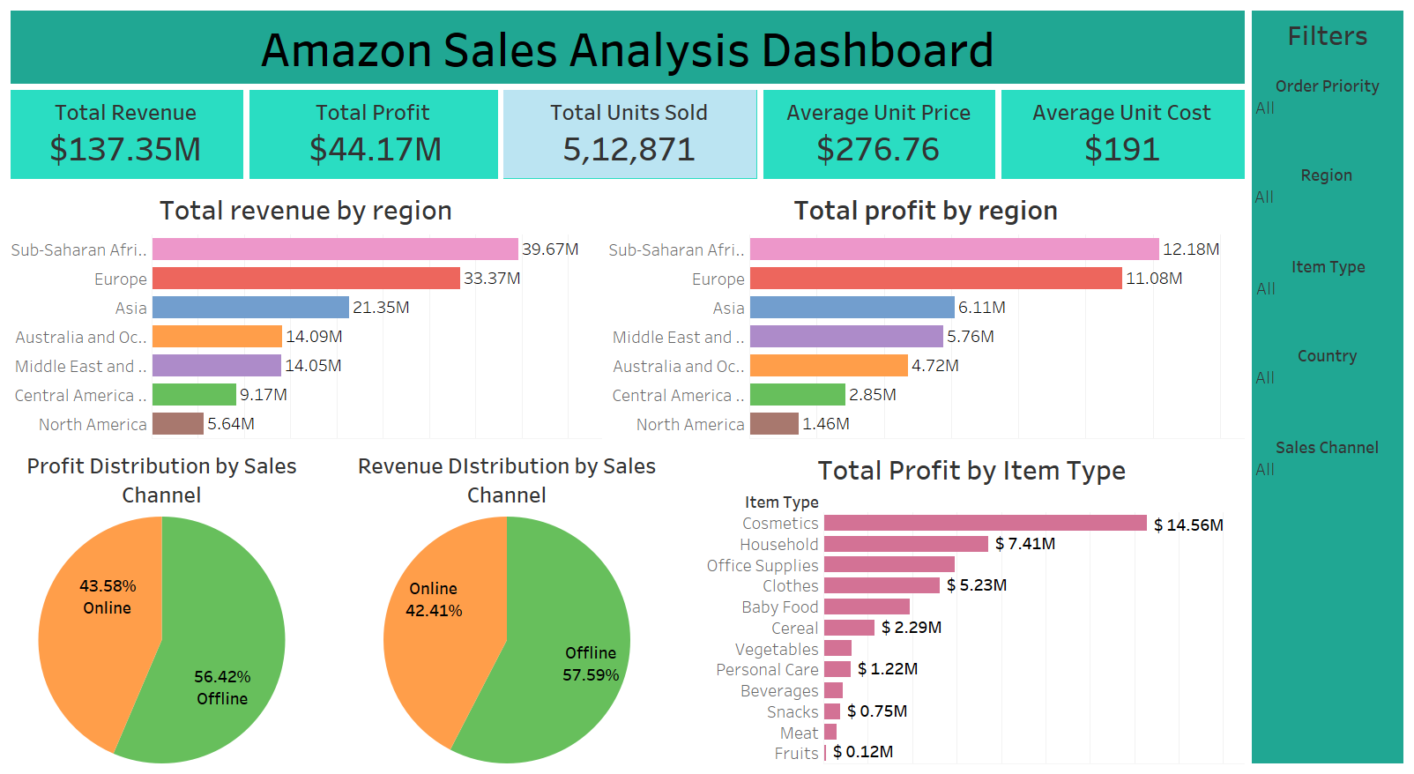

Slide 21
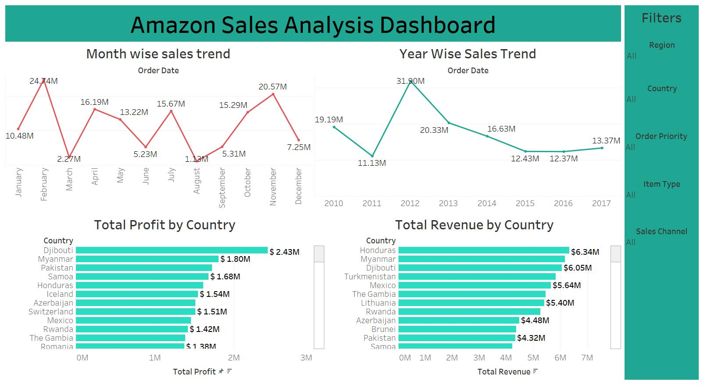

Slide 22
